Slide 1

VECTO 4.x
Release Notes

Slide 2
VECTO 0.11.2.3456 Development Version
18.06.2024
Release Notes

Slide 3
VECTO 3rd Amendment Development Version 18.06.2024
Features
CodeEU-196: Implement wheel bearings
Input for Engineering mode is available via the GUI & JSON file. In the vehicle file (.vveh) in an entry of the "Axles" array, you can add the field "WheelEndFriction" and assign it a numerical value. Input for Declaration mode is available via a temporary XSD (VectoDeclarationDefinitions.DEV.2.6.xsd). Sample file in folder: Generic Vehicles\Declaration Mode\Wheel_Bearings
CodeEU-643: added support for fuel cell IEPC
Added new simulation job type for IEPC vehicles with fuel cells. This feature is only supported in engineering mode. The GUI has been amended to allow the creation/modification of this new job type. A sample job has been added to the folder 'Generic Vehicles\Engineering Mode\GenericIEPC - FCHV'.

Slide 4
VECTO 3rd Amendment Development Version 18.06.2024
Bugfixes
CodeEU-236: Fuel Cell Simulation Aborts when Charging Power of Battery is too low
CodeEU-209: VECTO-0.11.1.3228-DEV crash in declaration mode
CodeEU-207: Writing XML Reports fails for vehicles without battery

Slide 5
VECTO 0.11.1.3382 Development Version
03.11.2023
Release Notes

Slide 6
VECTO 3rd Amendment Development Version 03.11.2023
Changes
Enabled the usage of multiple Fuel Cell Systems (FCS)
Up to two FCS Strings
Up to three FCS in each FCS String
New naming convention:
FCS: Single Fuel Cell System, described with MassFlowMap (.vfcm) and power limits container in the Fuel Cell System File (.vfcc).
FCS String: Defined in the .vveh file, can contain up to three identical FCS
CFCS: Composite Fuel Cell System, a virtual fuel cell system containing up to two FCS String.
Changes in input files due to new naming convention
Optimized power distribution among FCS Strings and between individual FCS inside a string.(Explained in more detail in the user manual)
Allow operating a FCS below its minimum power via time splitting
Removed On/Off – Hysteresis
Removed Gradient Power Change

Slide 7
VECTO 0.11.0.3193 Development Version
29.09.2023
Release Notes

Slide 8
First VECTO beta release for the 3rd Amendment H2 Internal Combustion Engines
TUG

Slide 9
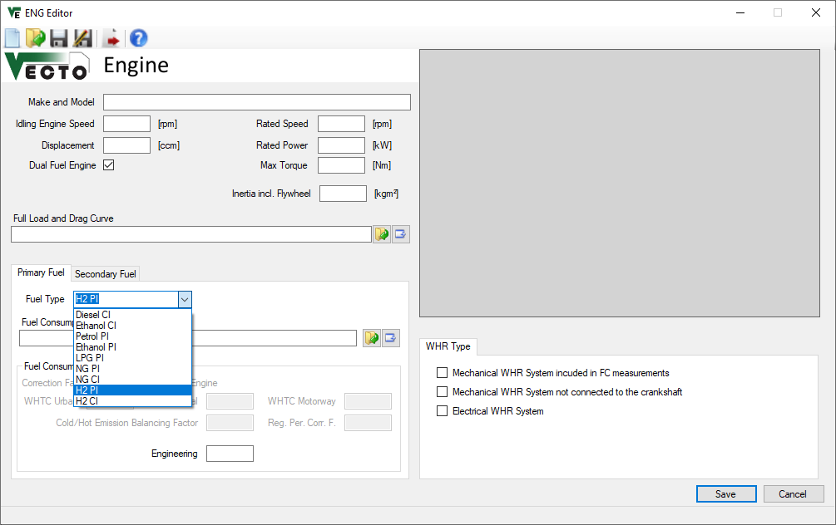
H2 ICE
New fuel types implemented „H2 PI“ and „H2 CI“ (i.e. H2-Diesel dual-fuel)
Well-known ICE input data structure unchanged, no new elements
Fuel characteristics used

Slide 10
First VECTO beta release for the 3rd Amendment Fuel Cell Hybrid Vehicles (FCHV)
TUG

Slide 11
Fuel cell hybrid vehicles (FCHV) – Op. strategy (1/5)
FCHV generic operation strategy (Charge Sustaining Mode) implemented as presented in TF FCS #15 with following basic principle:
Maximum phlegmatisation of FCS by operation strategy
FCS needs to provide average electric power demand over longer horizon
Longest possible averaging horizon depends on battery size and specific vehicle-cycle combination → The smaller the battery or the greater the electric energy demand of the vehicle, the smaller the averaging horizon will get leading to a more dynamic operation of the FCS.

Slide 12
Fuel cell hybrid vehicles (FCHV) – Op. strategy (2/5)
Basic approach for implementation of FCS operation in “CS” Mode in 4 steps
Pre-simulation run as PEV to determine electric power demand for propulsion and auxiliaries
Power limit of “special” battery defined as sum of respective maximum powers (BAT + FCS)
Resulting total electric power from step 1 will be averaged over a certain fixed window size which is distance based (details next slide)
Buffering of energy is limited by battery size, SOC limits min/max are not allowed to be exceeded
Using largest possible window size without violating SOC limits in any window
Adaption of start SOC to specific mission in order to maximize usage of battery as buffer
Actual simulation run as FCHV in-the-loop where FCS is operated following a fixed power trace to cover average electric power demand determined from pre-processing in step 2 (battery covers instantaneous deviations from average electric power demand)
ΔSOC correction in post-processing to account for small deviations from neutral SOC behaviour over cycle (e.g. variations in auxiliary power, small deviations in battery losses etc.)

Slide 13
Fuel cell hybrid vehicles (FCHV) – Op. strategy (3/5)
Averaging and window size explained (1/2)
The averaging window is placed distance-symmetrically over each actual time step from the pre-simulation
Window size is determined by total distance within window
distance
=
distance
=
window @ t+2
window @ t+1
window @ t
time
t-i
t+1-j
t+2+k
t
t+1
t+2
t+i
t+1+j
t+2+k

Slide 14

Fuel cell hybrid vehicles (FCHV) – Op. strategy (4/5)
Averaging and window size explained (2/2)
Maximum window size is given by complete cycle, thus cycle is concatenated 3 times in a row
For time steps near the beginning or end of the cycle, the windows expand over the actual cycle and continue at the adjacent parts at the end or beginning.
speed
window at beginning of cycle
window in the middle of cycle
window at end of cycle
time
previous copy of cycle
actual cycle
subsequent copy of cycle

Slide 15
Fuel cell hybrid vehicles (FCHV) – Op. strategy (5/5)
Actual simulation run as FCHV and applicable boundary conditions
In case average power demand over total cycle is higher than FCS maximum power: → defined error message and simulation is aborted (vehicle configuration not reasonable for this mission, should not occur in practice)
In case average power in a certain timestep is lower than FCS minimum power: → FCS is switched off → missing energy from FCS for those timesteps will be accounted for in post-processing via ΔSOC correction

Slide 16
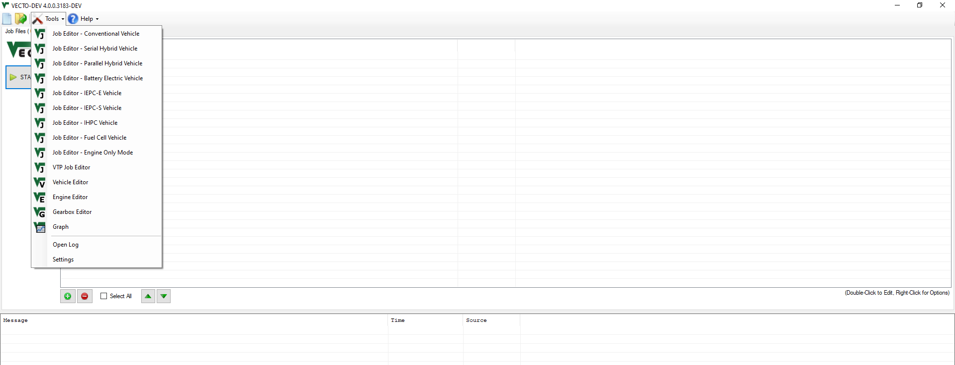
Fuel cell hybrid vehicles (FCHV) – VECTO features (1/5)
New powertrain type of FCHV added to Job Editor

Slide 17
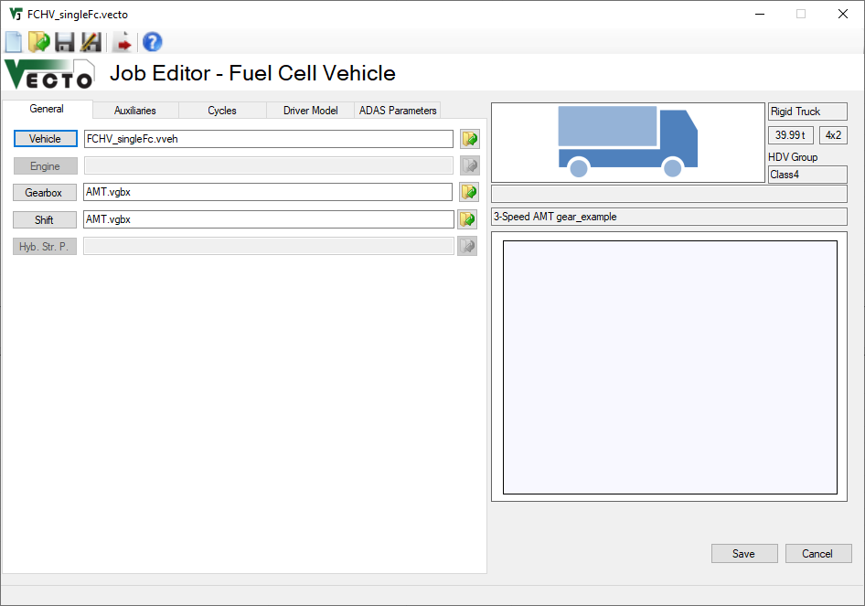
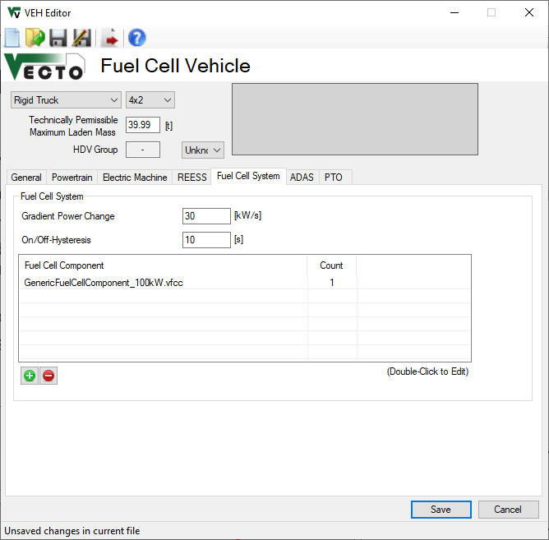
Fuel cell hybrid vehicles (FCHV) – VECTO features (2/5)
FCS to be parameterized via specific „Fuel Cell System“ tab in „Vehicle“ editor
Power gradient limits change in FCS power over time
On/off-Hysteresis is minimum time that FCS stays off or on after state change occurs → not required anymore after insights gained during work on implementation of multiple FCS

Slide 18
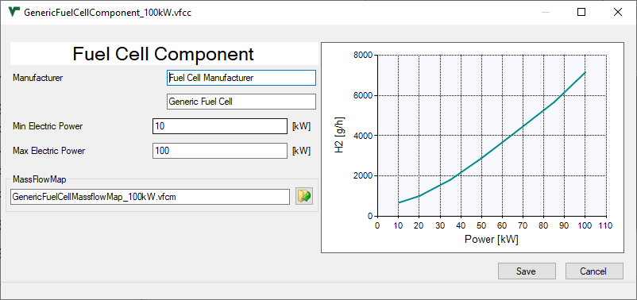
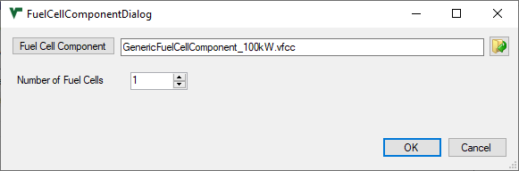
Fuel cell hybrid vehicles (FCHV) – VECTO features (3/5)
FCS to be parameterized via specific „Fuel Cell System“ tab in „Vehicle“ editor
Double-click or „+“
Max / min power limits operation range of FCS component
FCS mass flow map needs to cover the indicated range
Limited to 1
for this release

Slide 19
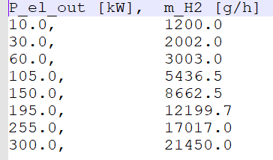
Fuel cell hybrid vehicles (FCHV) – VECTO features (4/5)
FCS to be parameterized via specific „Fuel Cell System“ tab in „Vehicle“ editor
Input data structure for FCS H2 mass flow map
CSV file format
1st column: Electric power output of FCS in [kW]
2nd column: H2 mass flow in [g/h]
FCS component efficiency should also include DC/DC converter (as this is part of component test procedure)!
Example data

Slide 20
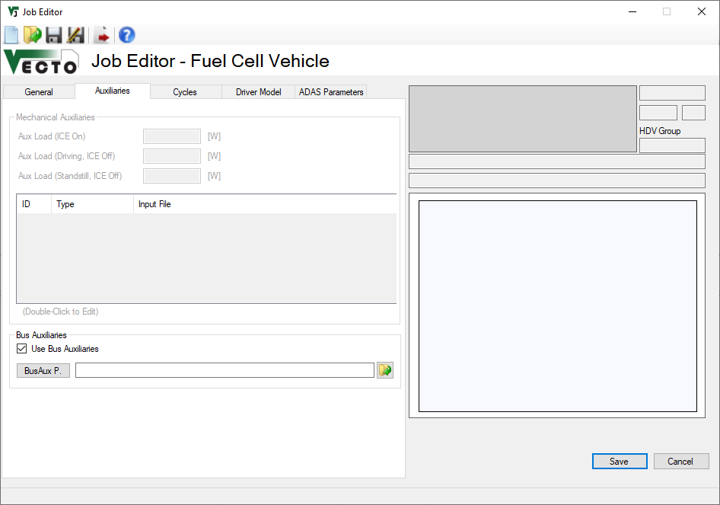
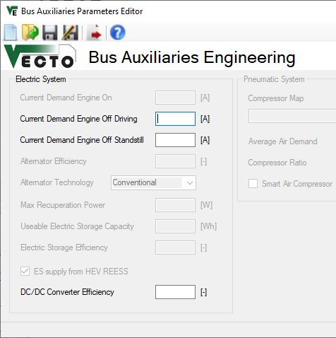
Fuel cell hybrid vehicles (FCHV) – VECTO features (5/5)
Parameterization of auxiliaries for FCHV
Electric power demand of auxiliaries for both, lorries and buses, need to be parameterized via the “Bus Auxiliaries” GUI window
INFO: Electric aux power demand is calculated by multiplying the specified current values by a voltage of 28.3V
Demand during vehicle driving
Demand during vehicle standstill

Slide 21
FCHV – Examples for generic operation strategy (1/5)
Exemplary results for VECTO Group 2 12-ton rigid lorry (9.5 ton actual mass) on following slides
Simulation in VECTO Urban Delivery Cycle
Average electric power demand around 22 kW
FCHV powertrain specifications:
100 kW FCS max power
following variants of battery:
5 kWh
10 kWh
20 kWh
Resulting speed profile was exactly the same for all different configurations

Slide 22
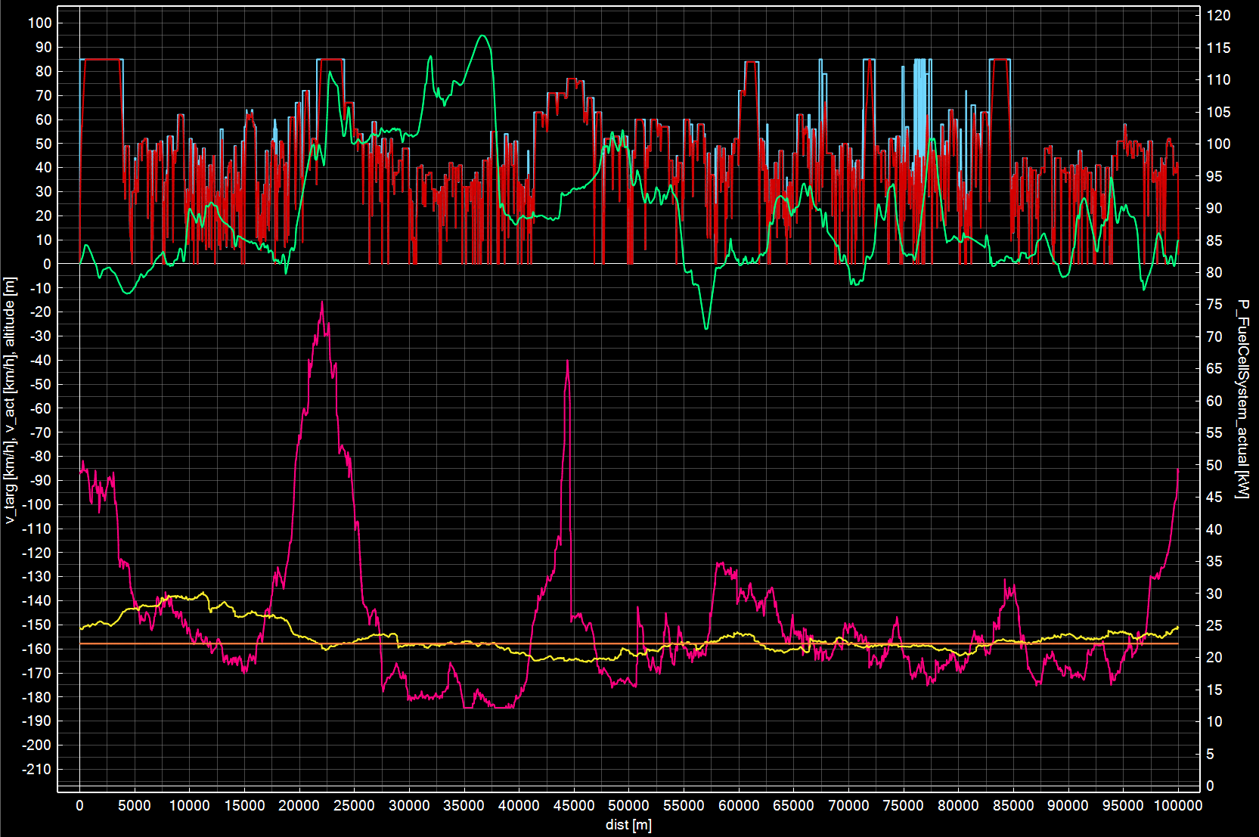
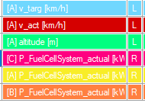
FCHV – Examples for generic operation strategy (2/5)
The lower the buffer size, the more dynamic the FCS operation gets
Exactly same speed profile for all variants
Averaging window sizes determined:
5 kWh: 6 km
10 kWh: 37.5 km
20 kWh: 100 km
Fuel cell power for different battery sizes
5 kWh
10 kWh
20 kWh

Slide 23
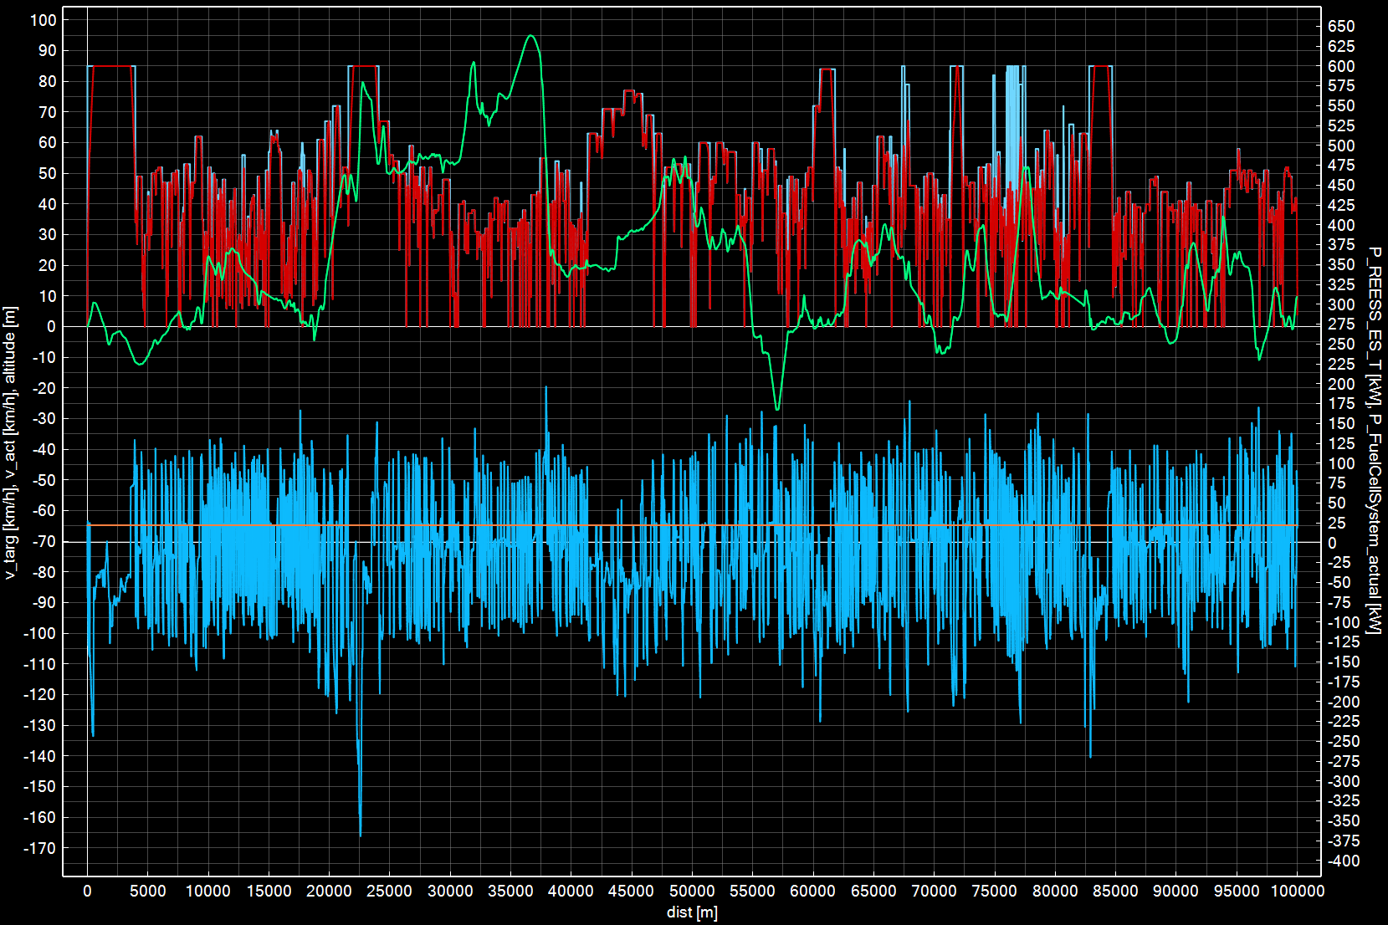
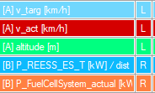
FCHV – Examples for generic operation strategy (3/5)
Battery covers instantaneous deviations from average electric power demand
Average electric power demand (i.e. FCS power) constant for the setting shown with 20 kWh REESS size
Battery power
Fuel cell power

Slide 24
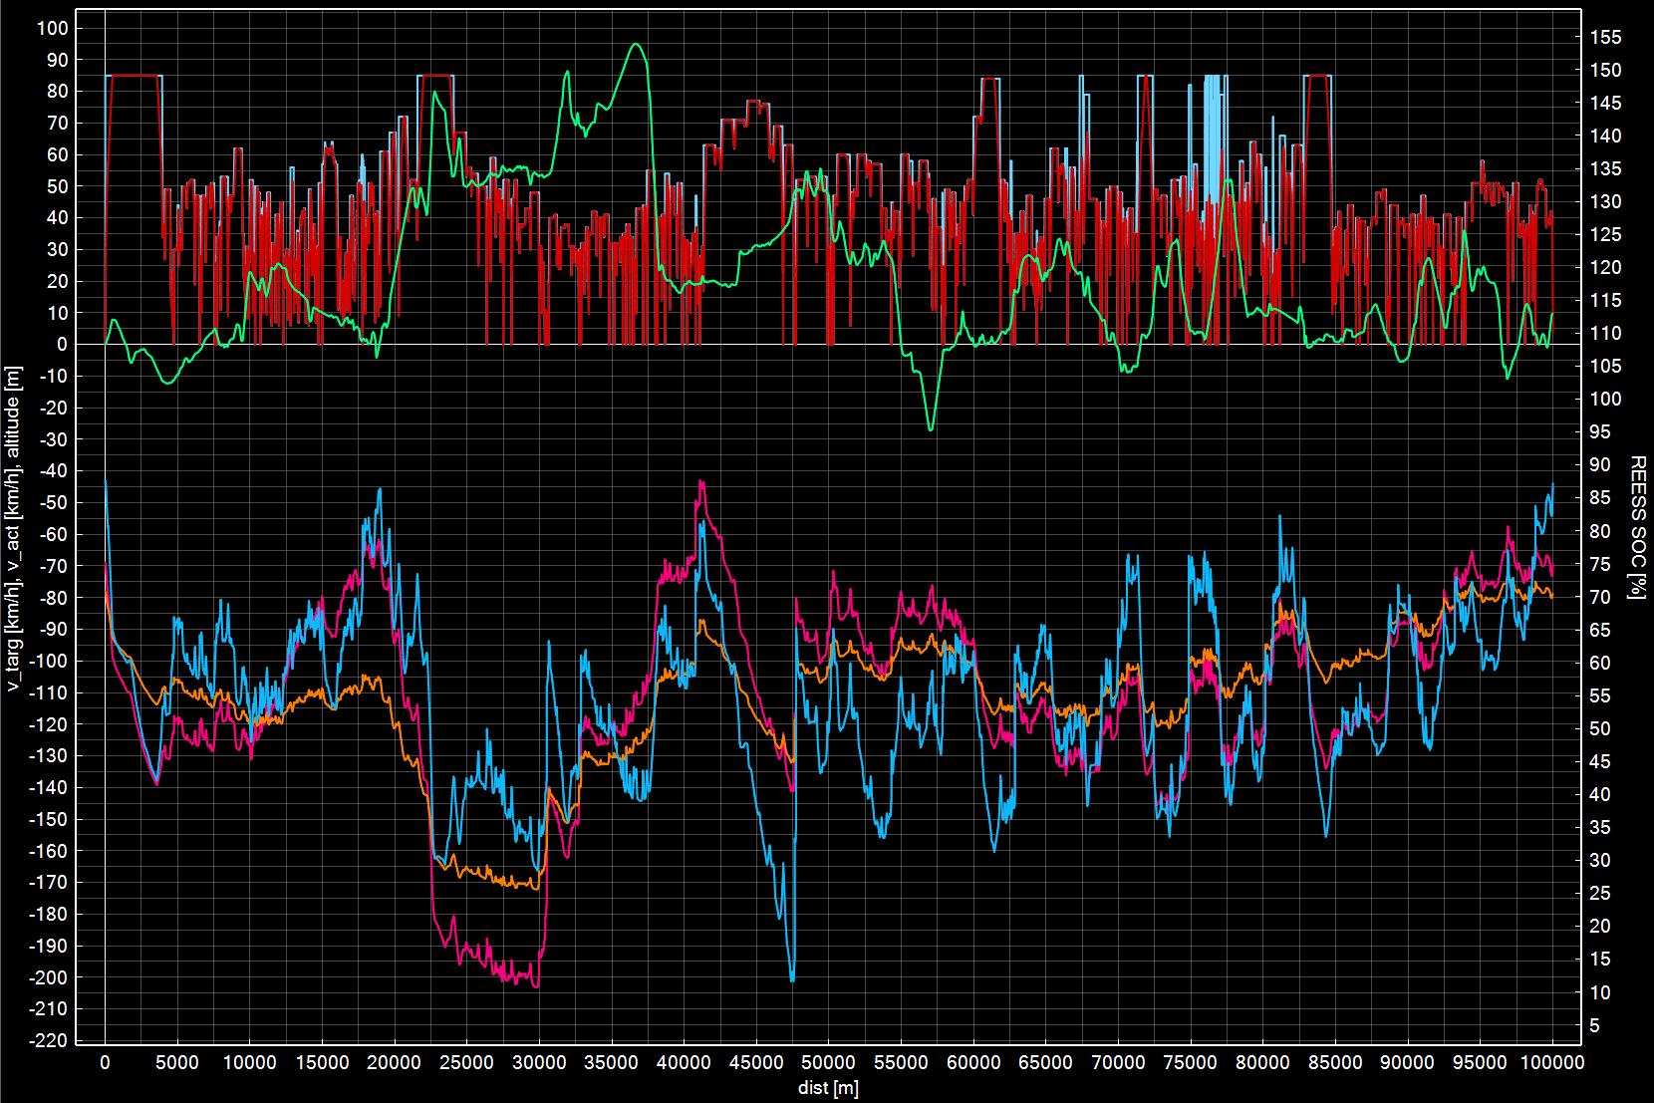
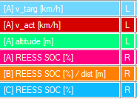
FCHV – Examples for generic operation strategy (4/5)
Using largest possible window size without violating SOC limits in any window → maximizing of battery buffer usage
Exactly same speed profile for all variants
SOC limits are Engineering settings, no connex to generic limits used in Declaration Mode
Upper SOC limit
Lower SOC limit
SOC for different battery sizes
5 kWh
10 kWh
20 kWh

Slide 25
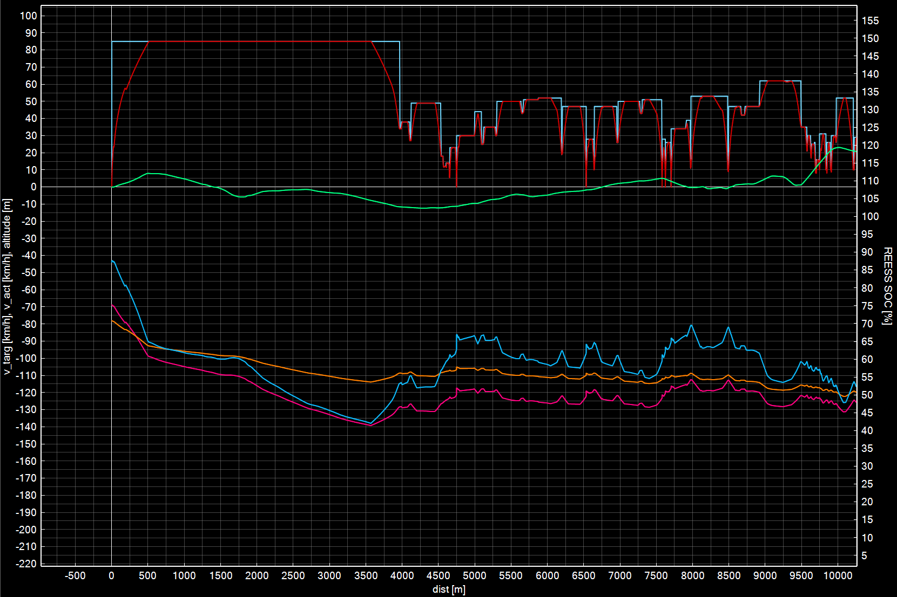
FCHV – Examples for generic operation strategy (5/5)
Adaption of start SOC to specific mission in order to maximize usage of battery as buffer (detail from previous graph)
Exactly same speed profile for all variants
Adapted start SOC
SOC for different battery sizes
5 kWh
10 kWh
20 kWh

Slide 26
Fuel cell hybrid vehicles (FCHV) - Comments
Release to be distributed via VECTO-DEV mailing list end of September
Basic description of FCHV features will also be added to VECTO release notes
Some example vehicles will be provided
Current release restricted to one single FCS component
Updated release end of October will be able to handle:
multiple FCS configurations as presented in TF FCS #17
Maximum 2x3 configuration i.e. 2 different FCS with a maximum number of 3 identical systems for each of the 2 different ones
Special provisions for handling power demands below minimum FCS power
IMC feature combined with FCHV

Slide 27
First VECTO beta release for the 3rd Amendment Vehicles with In-Motion Charging Features
TUG

Slide 28
Vehicles with In-Motion Charging (IMC) features (1/11)
One of the tasks of the pre-development project for the 3rd Amendment was to analyse different systems for in-use charging of electric vehicles
State of the art
Relevance and possible paths of implementation to Regulation (EU) 2017/2400
Functional prototype
The analyses and proposals for (1) and (2) were presented and discussed with stakeholders in five stakeholder meetings (Oct 2021, Dec 2021, Jan 2022, Jun 2022 and Sept 2022).
The following slides summarise the most important principles and present the functional prototype

Slide 29
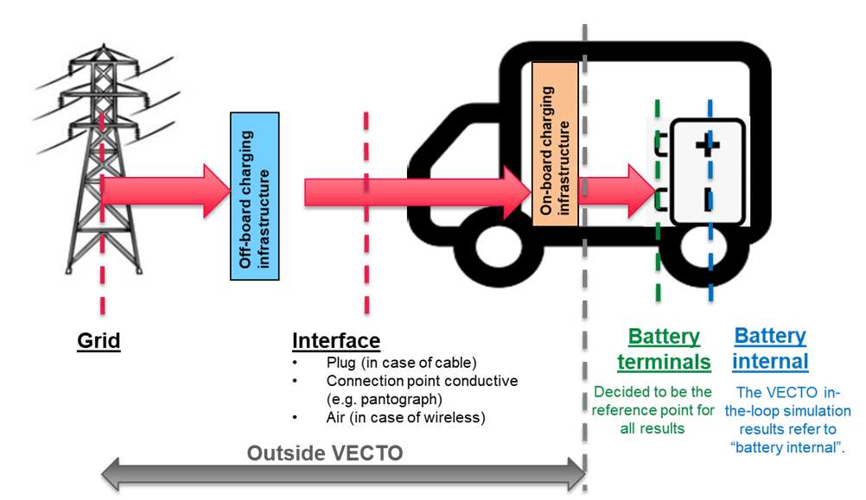
Vehicles with In-Motion Charging (IMC) features (2/11)
Reference point for results regarding electric energy consumption
Principle applied already for the 2nd amendment
Consequences for the 3rd amendment
Stationary charging: minor improvements to the Annex (max. charging power)
In-motion charging: Requires model extension and separate provisions in the Annex

Slide 30
Vehicles with In-Motion Charging (IMC) features (3/11)
Modelling in VECTO - Overview
Driving with “direct feed” incorporated to simulations of “charge depleting” mode by postprocessing (no additional sim time, no additional definitions etc.) (DECL) → higher utility factor / share of electric driving for OVC-HEV → (slightly) lower battery internal losses
Charging of batteries by IMC handled by postprocessing (DECL) → higher utility factor / share of electric driving for OVC-HEV
Impact on air drag incorporated to in-the loop simulation via a mission average share “active” (which applies either to motorway sections or to the total cycle) (ENG, DECL)
No direct influence on the “electric ranges", i.e. these are also only calculated on the basis of the usable battery capacity (DECL)
DECL / ENG: Effect visible in Declaration Mode / Engineering Mode
Report with detailed documentation to be published soon

Slide 31
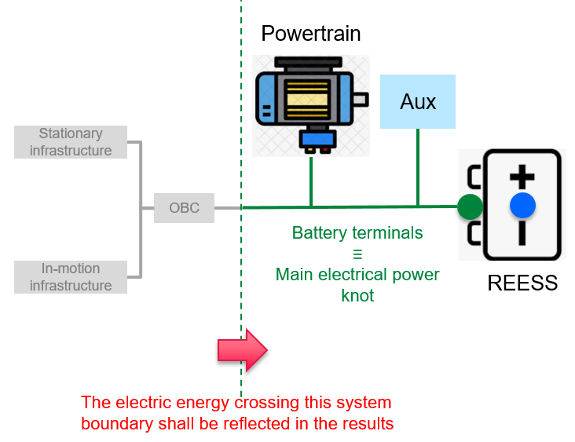
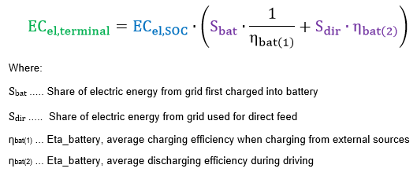
Vehicles with In-Motion Charging (IMC) features (4/11)
Modelling in VECTO – Calculations of electric energy consumption at battery terminals
Lila terms: new elements introduced for IMC modelling
Calculation examples see Task3_Masterexcel_OVC_IMC.xlsx as distributed with ppt Report with detailed documentation to be published soon

Slide 32
Vehicles with In-Motion Charging (IMC) features (5/11)
Modelling in VECTO – Current proposals for Declaration Mode
In-motion charging “technology” | Relevance |  |  | Proposal for definition in Regulation (EU) 2017/2400
 | Heavy lorries | Heavy buses | Medium lorries
Overhead pantograph | Yes | Yes | No | Vehicle equipped with overhead pantograph for connection with overhead catenary infrastructure as regulated by standard tbd and which is not overhead trolley.
Overhead trolley | No | Yes | No | Vehicle equipped with poles for connection with overhead catenary infrastructure as regulated in Annex 12 to UN Regulation 107 revision 8.
Ground-rail | Yes¹ | Yes¹ | Yes¹ | Charging technology that conductively transfers the electrical energy to the vehicle through rails embedded in or on top of the road surface.
Wireless | Yes¹ | Yes¹ | Yes¹ | Charging technology that inductively transfers the electrical energy to the vehicle through devices embedded in or on top of the road surface providing magnetic fields as they are specified IEC 61980.
¹ Only Potential niche applications are conceivable.
Lila: to be worked out for the 3rd amendment

Slide 33
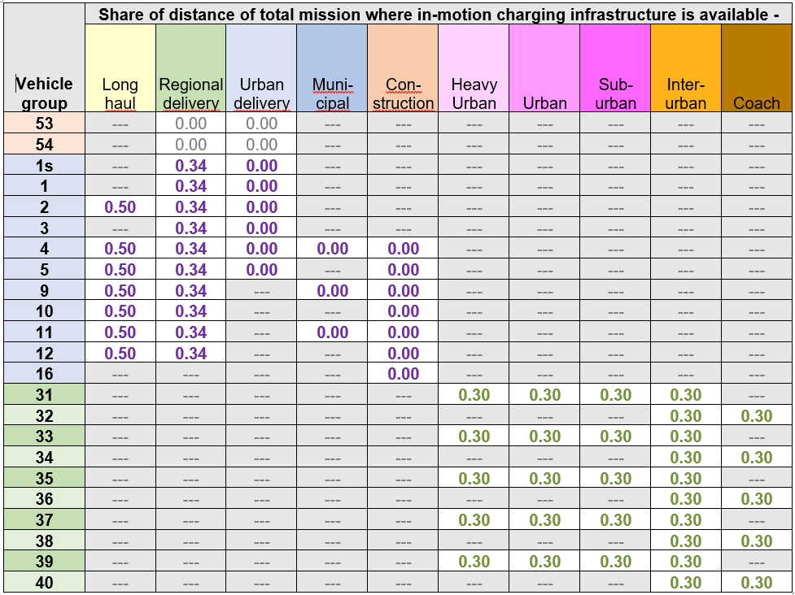
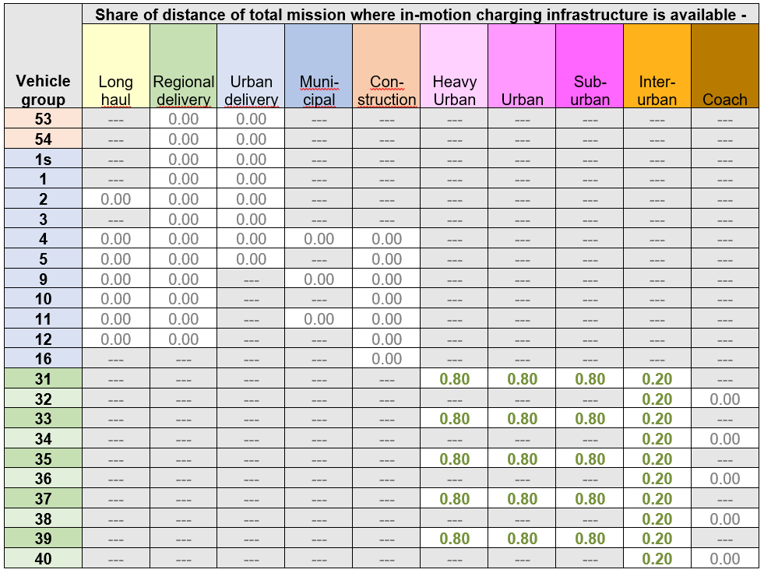
Vehicles with In-Motion Charging (IMC) features (6/11)
Modelling in VECTO – Proposal for IMC infrastructure availability
Overhead - Pantograph
Overhead - Trolley

Slide 34
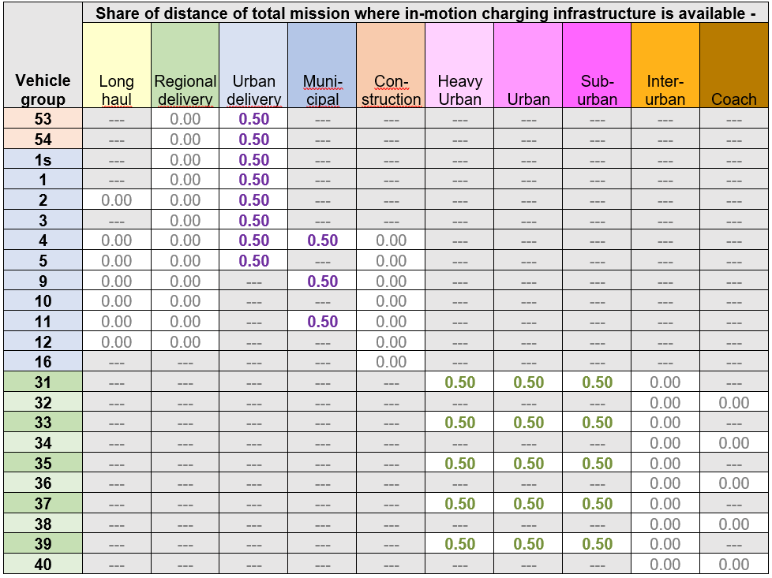
Vehicles with In-Motion Charging (IMC) features (7/11)
Modelling in VECTO – Proposal for IMC infrastructure availability
Ground rail + Wireless

Slide 35
Vehicles with In-Motion Charging (IMC) features (8/11)
Modelling in VECTO – Further proposed assumptions
Battery charging during mission
50% of usable battery capacity via “SOC lift” by IMC
No further stationary charging
Air drag
Considered only for “Overhead – pantograph”
ΔCdxA = 0.6 m² for the shares in the mission where IMC is available

Slide 36
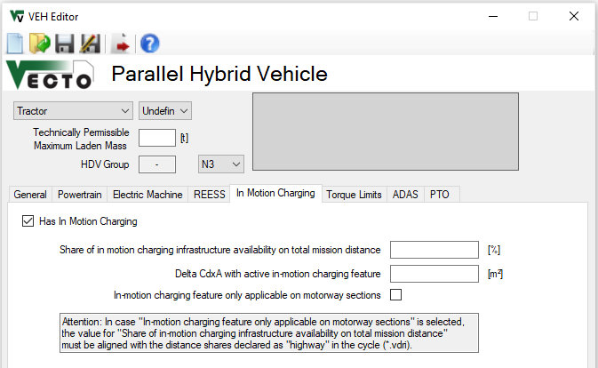
Vehicles with In-Motion Charging (IMC) features (9/11)
Inputs in Graphical User Interface (ENG)
New tab in “VEH Editor” for HEV and PEV vehicles
Attention!
Working with ENG mode simulations for IMC features requires detailed knowledge of the proposed approach (mainly for developers)
For checking of regulatory impact DECL mode testing recommended!

Slide 37
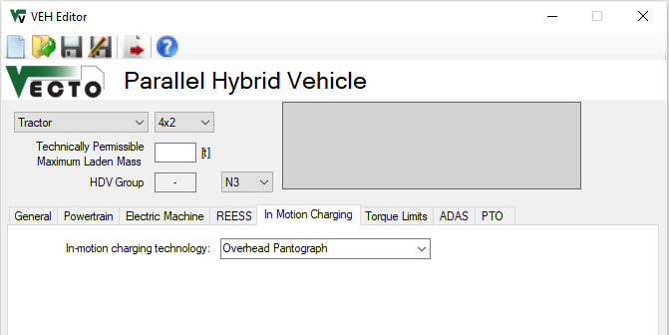
Vehicles with In-Motion Charging (IMC) features (10/11)
Inputs in Graphical User Interface (DECL)
Dropdown Menu with pre-defined technologies
None
Overhead Pantograph
Overhead Trolley
Ground Rail
Wireless

Slide 38
Vehicles with In-Motion Charging (IMC) features (11/11)
Example vehicle models will be distributed with the release (located in “\Generic vehicles”)
Base specs example models
Group 5 / HEV P2 / OVC: P_{cont_EM}: 200kW | E_{Reess}: 120kWh nominal
Group 5 / PEV: P_{cont_EM}: 325kW | E_{Reess}: 170kWh nominal
Example results: Long haul with rep payload Comparison results “w/o” and “w/” pantograph with similar other vehicle specs like mass
Group 5 / P2 / OVC w/o pantograph: UF = 0.149; CO2_{weighted} = 692.2 g/km
Group 5 / P2 / OVC w/ pantograph: UF = 0.660; CO2_{weighted} = 347.1 g/km → -50% CO2
Group 5 / PEV w/o pantograph: EC_{el} = 1.262 kWh/km
Group 5 / PEV w/ pantograph: EC_{el} = 1.297 kWh/km → +2.8% EC_{el}

